Slide 1

ANÁLISIS DE DATOS ESPACIALES
EDIER V. ARISTIZÁBAL G.
Ing. Geólogo (Universidad Nacional de Colombia)
Esp. en Gestión de Riesgos Geológicos (Universidad de Ginebra – Suiza)
MSc. en Geociencias (Universidad de Shimane – Japón)
PhD. en Ingeniería (Universidad Nacional de Colombia)
Universidad Nacional de Colombia
Facultad de Minas
Departamento de Geociencias

Slide 2

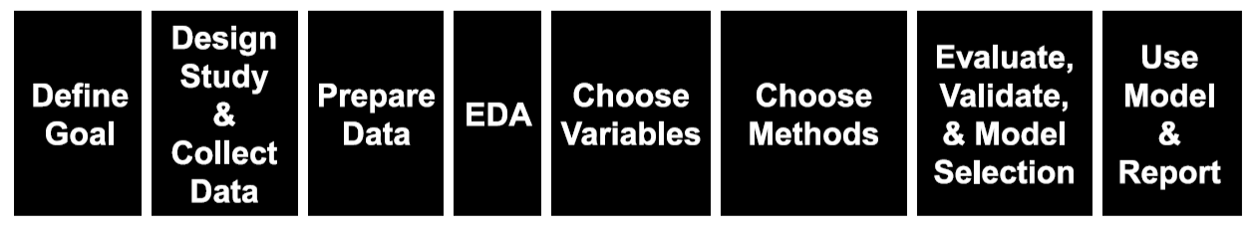
PROCEDIMIENTO GENERAL
Label & one-hot encoding
Correlation
Handling missing values
Data partitioning
Outlier detection
Unbalanced data
Scaling

Slide 3
SELECCIÓN DE VARIABLES
Often, in a high dimensional dataset, there remain some entirely irrelevant, insignificant and unimportant features. It has been seen that the contribution of these types of features is often less towards predictive modeling as compared to the critical features. They may have zero contribution as well. These features cause a number of problems which in turn prevents the process of efficient predictive modeling.
Unnecessary resource allocation for these features.
These features act as a noise for which the machine learning model can perform terribly poorly.
The machine model takes more time to get trained.

Slide 4
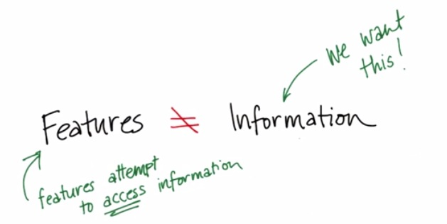
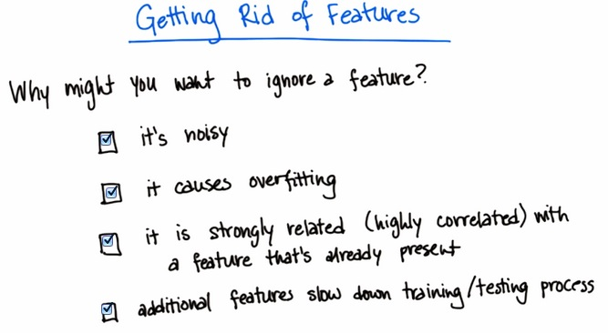
SELECCIÓN DE VARIABLES

Slide 5
SELECCIÓN DE VARIABLES
Let me summarize the importance of feature selection for you:
It enables the machine learning algorithm to train faster.
It reduces the complexity of a model and makes it easier to interpret.
It improves the accuracy of a model if the right subset is chosen.
It reduces Overfitting.

Slide 6
FEATURE SELECTION ≠ FEATURE TRANSFORMATION
Sometimes, feature selection is mistaken with dimensionality reduction. But they are different. Feature selection is different from dimensionality reduction. Both methods tend to reduce the number of attributes in the dataset, but a dimensionality reduction method does so by creating new combinations of attributes (sometimes known as feature transformation), whereas feature selection methods include and exclude attributes present in the data without changing them.

Slide 7
TIPOS DE FEATURES
Diseñar tus features es un arte más que una ciencia. Tus features son más útiles mientras más correlación tengan tu variable objetivo.
Features Independientes: Para no tener redudancias tus features deberían ser lo más independientes posible entre ellas.
Cantidad de Features controlada: Nuestra intuición nos falla en dimensiones superiores a 3. En la mayoría de los casos aumentar la cantidad de features afecta negativamente la performance si no contamos con una gran cantidad de datos. Por ultimo pocas features aseguran una mejor interpretabilidad de los modelos

Slide 8
FILTER METHODS
Filter method relies on the general uniqueness of the data to be evaluated and pick feature subset, not including any mining algorithm. Filter method uses the exact assessment criterion which includes distance, information, dependency, and consistency.

Slide 9
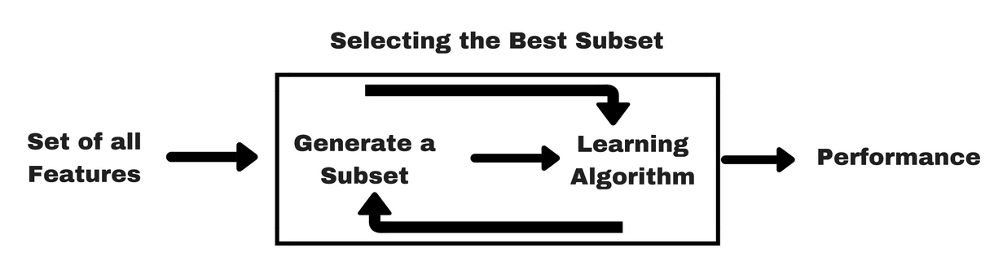
WRAPPER METHODS
A wrapper method needs one machine learning algorithm and uses its performance as evaluation criteria. This method searches for a feature which is best-suited for the machine learning algorithm and aims to improve the mining performance. Recursive Feature elimination: Recursive feature elimination performs a greedy search to find the best performing feature subset. It iteratively creates models and determines the best or the worst performing feature at each iteration. It constructs the subsequent models with the left features until all the features are explored. It then ranks the features based on the order of their elimination. In the worst case, if a dataset contains N number of features RFE will do a greedy search for 2^{N} combinations of features.

Slide 10
EMBEDDED METHODS
Embedded methods are iterative in a sense that takes care of each iteration of the model training process and carefully extract those features which contribute the most to the training for a particular iteration. Regularization methods are the most commonly used embedded methods which penalize a feature given a coefficient threshold.

Slide 11
FILTER vs WRAPPER METHODS
Filter methods do not incorporate a machine learning model in order to determine if a feature is good or bad whereas wrapper methods use a machine learning model and train it the feature to decide if it is essential or not.
Filter methods are much faster compared to wrapper methods as they do not involve training the models. On the other hand, wrapper methods are computationally costly, and in the case of massive datasets, wrapper methods are not the most effective feature selection method to consider.
Filter methods may fail to find the best subset of features in situations when there is not enough data to model the statistical correlation of the features, but wrapper methods can always provide the best subset of features because of their exhaustive nature.
Using features from wrapper methods in your final machine learning model can lead to overfitting as wrapper methods already train machine learning models with the features and it affects the true power of learning. But the features from filter methods will not lead to overfitting in most of the cases

Slide 12
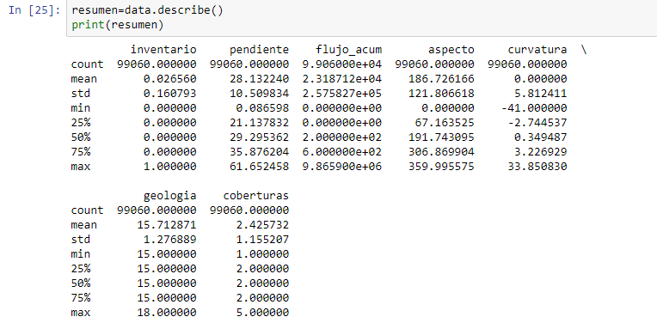
ANÁLISIS DE LAS VARIABLES

Slide 13
Histograms, Rug Plots, and KDE Interpolation
Describes distribution of data – relative prevalence of values
Histogram
relative frequency of values
Tradeoff of bin sizes
Rug Plot
Shows the actual data locations
Smoothed density estimator
Tradeoff of “bandwidth” parameter (more on this later)
Main Mode
Smoothed Density Estimator
Second Mode
Skew Right
Histogram
Outliers
Gap
Rug

Slide 14
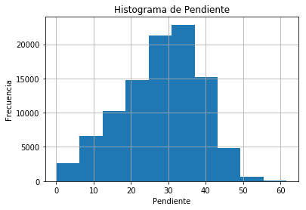
ANÁLISIS DE LAS VARIABLES: UNIVARIADO

Slide 15
Box Charts
Useful for summarizing distributions and comparing multiple distributions
Outliers
Outliers are 1.5 * IQR away from lower and upper quartiles.
Wisker
Upper Quartile
Interquartile
Range (IQR)
50% of Data
Median
Lower Quartile
Notes:
(1) Friday non-smokers seem to have higher bills

Slide 16
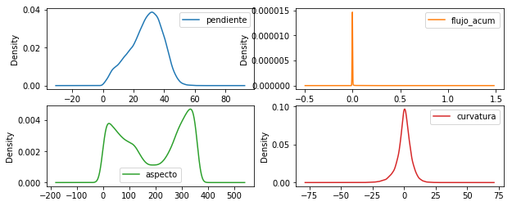
ANÁLISIS DE LAS VARIABLES

Slide 17
Bar Charts
Used to compare nominal and ordinal data.
Consider sorting by category or frequency

Slide 18
Visualizing Multivariate Relationships
Conditioning on a range of values (e.g., ages in groups) and construct side by side box-plots or bar charts
Comparison of Restaurant Bills
Titanic Survivors

Slide 19
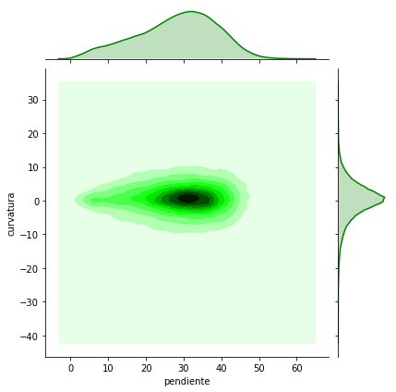
RELACIÓN ENTRE VARIABLES: BIVARIADO

Slide 20
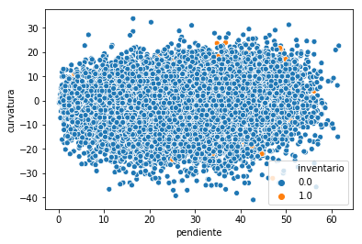
RELACIÓN ENTRE VARIABLES: MULTIVARIADO

Slide 21
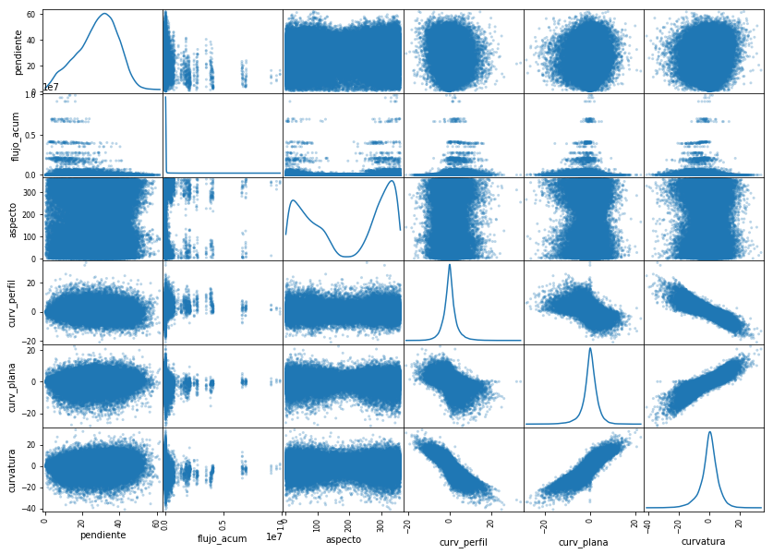
RELACIÓN ENTRE VARIABLES

Slide 22
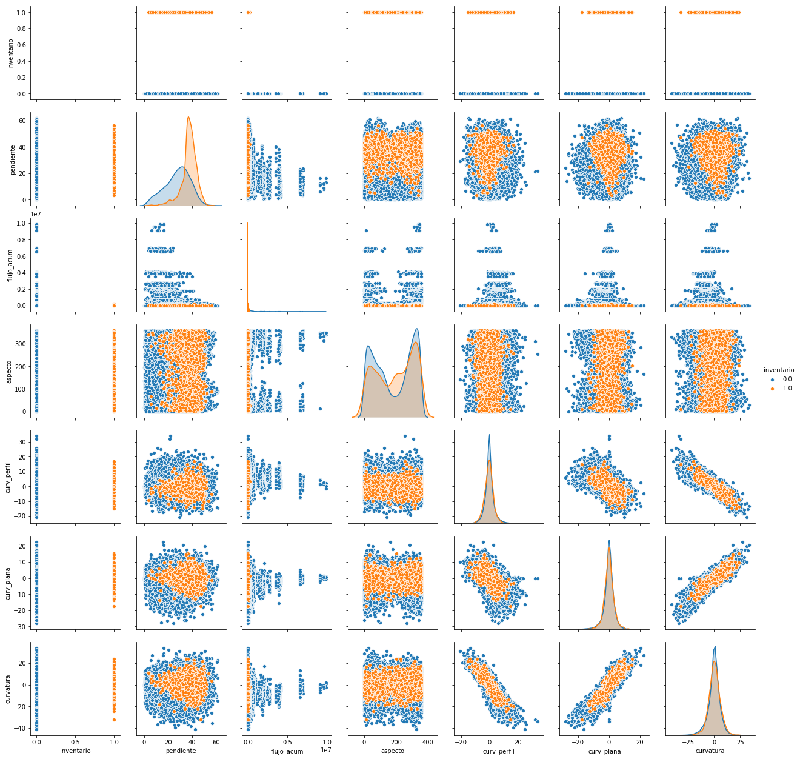
RELACIÓN ENTRE VARIABLES

Slide 23
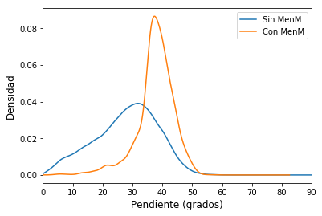
RELACION CON LA VARIABLE DEPENDIENTE

Slide 24
HISTOGRAMAS CON Y SIN MenM

Slide 25
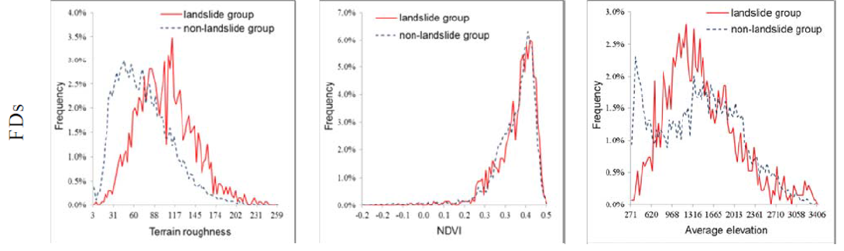
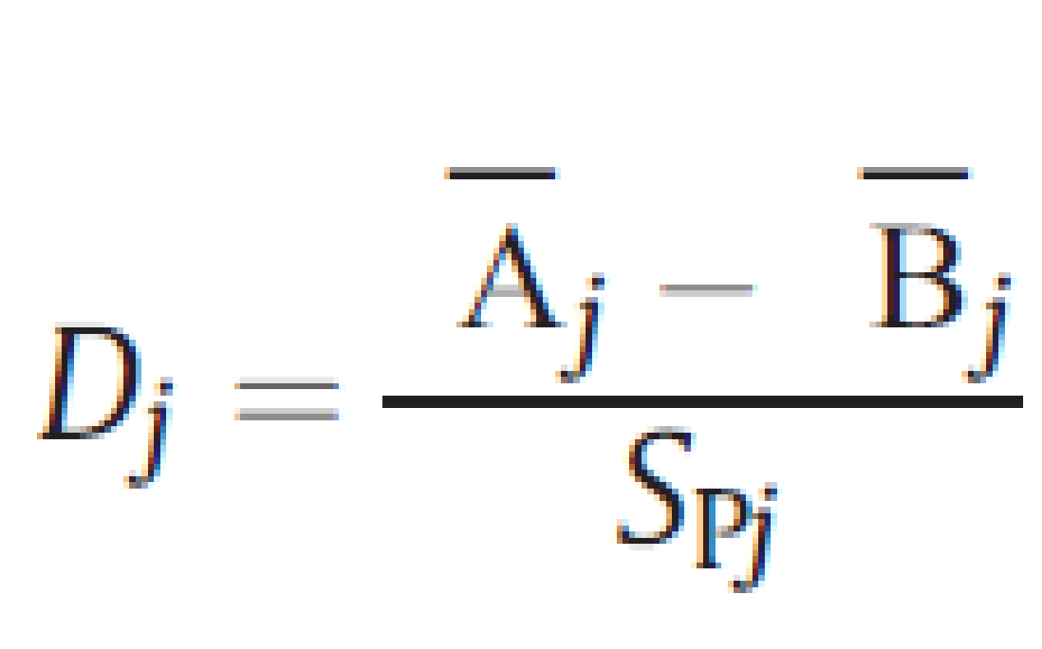
DISTRIBUCIÓN DE FRECUENCIAS
El valor absoluto de el Discriminante D_{j} tiene que exceder 0.1. Un valor mayor a 0 indica que el valor medio del grupo de deslizamiento es relativamente mayor y un valor menor que 0 indica que el grupo de no-deslizamientos tiene un valor medio mayor.
Funte: Wu & Chen (2013)

Slide 26
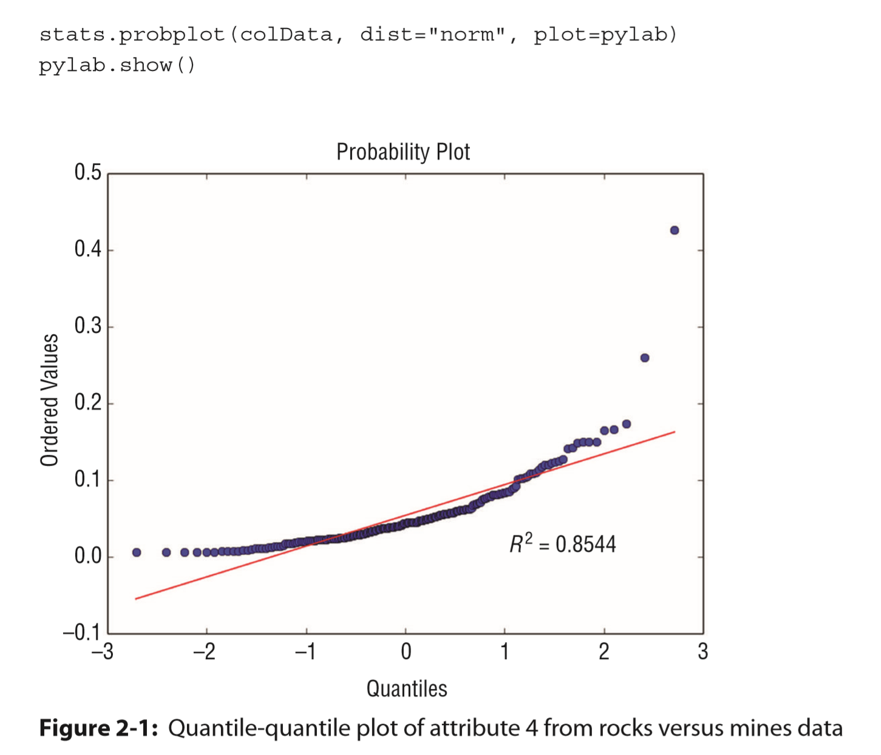
DISTRIBUCIÓN DE FRECUENCIAS

Slide 27
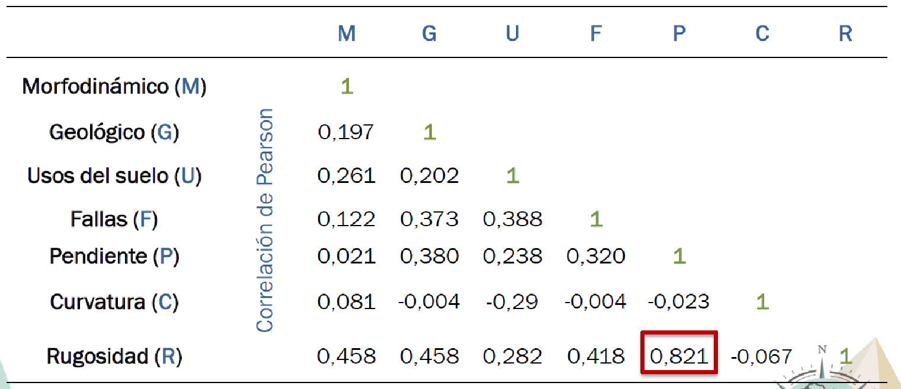
INDEPENDENCIA DE LAS VARIABLES
Correlación entre variables
Fuente: Rincón et al. (2016)

Slide 28
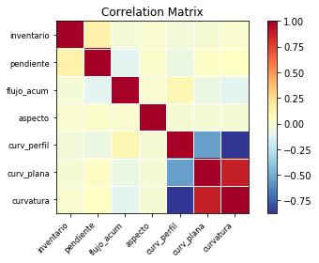
INDEPENDENCIA DE LAS VARIABLES

Slide 29
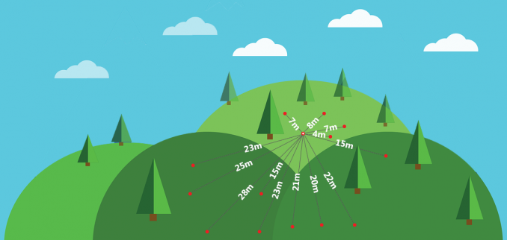
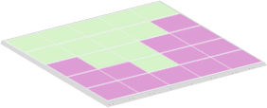
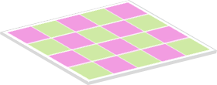
CORRELACIÓN ESPACIAL
Spatial autocorrelation in GIS helps understand the degree to which one object is similar to other nearby objects. Moran’s I (Index) measures spatial autocorrelation.
Geographer Waldo R. Tobler’s stated in the first law of geography:
“Everything is related to everything else, but near things are more related than distant things.”
Spatial autocorrelation definition measures how much close objects are in comparison with other close objects. Moran’s I can be classified as positive, negative and no spatial auto-correlation.
Positive spatial autocorrelation is when similar values cluster together in a map.
Negative spatial autocorrelation is when dissimilar values cluster together in a map.
+
-

Slide 30
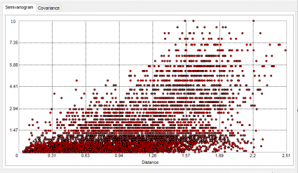
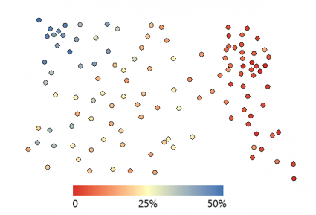

Slide 31
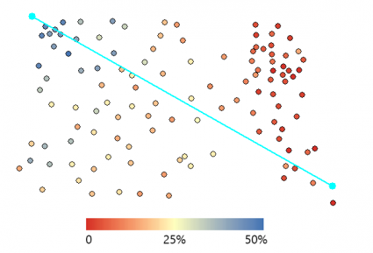
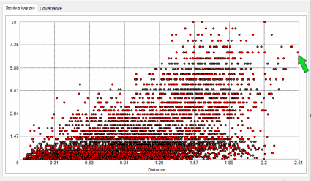
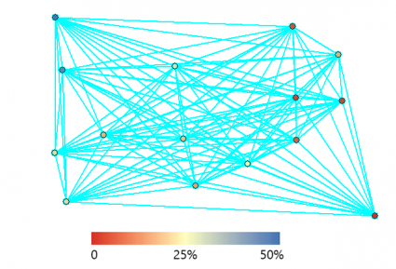
CORRELACIÓN ESPACIAL
Our example contains 73 soil moisture samples in a 10 acre field. In the north-west corner, the samples are much wetter with higher water content. But in the eastern quadrant, they are much dryer as color-coded in the image below.

Slide 32
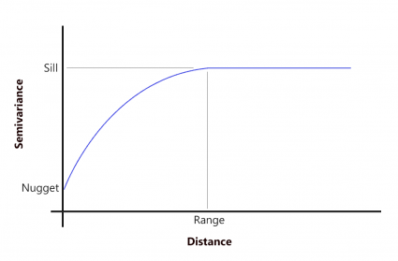
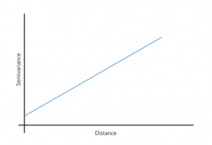
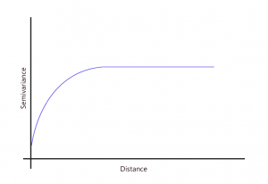
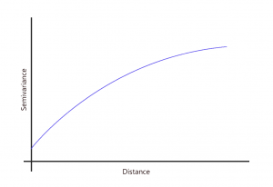
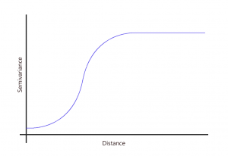
CORRELACIÓN ESPACIAL
But when sample point distances are farther away, they are less likely to be similar. This means that the semi-variance becomes large. As distance increases away from sample points, there is no longer a relationship between the sample points. Their variance begins to flatten out, and sample values are not related to one another.
SILL: The value at which the model first flattens out.
RANGE: The distance at which the model first flattens out.
NUGGET: The value at which the semi-variogram (almost) intercepts the y-value.

Slide 33
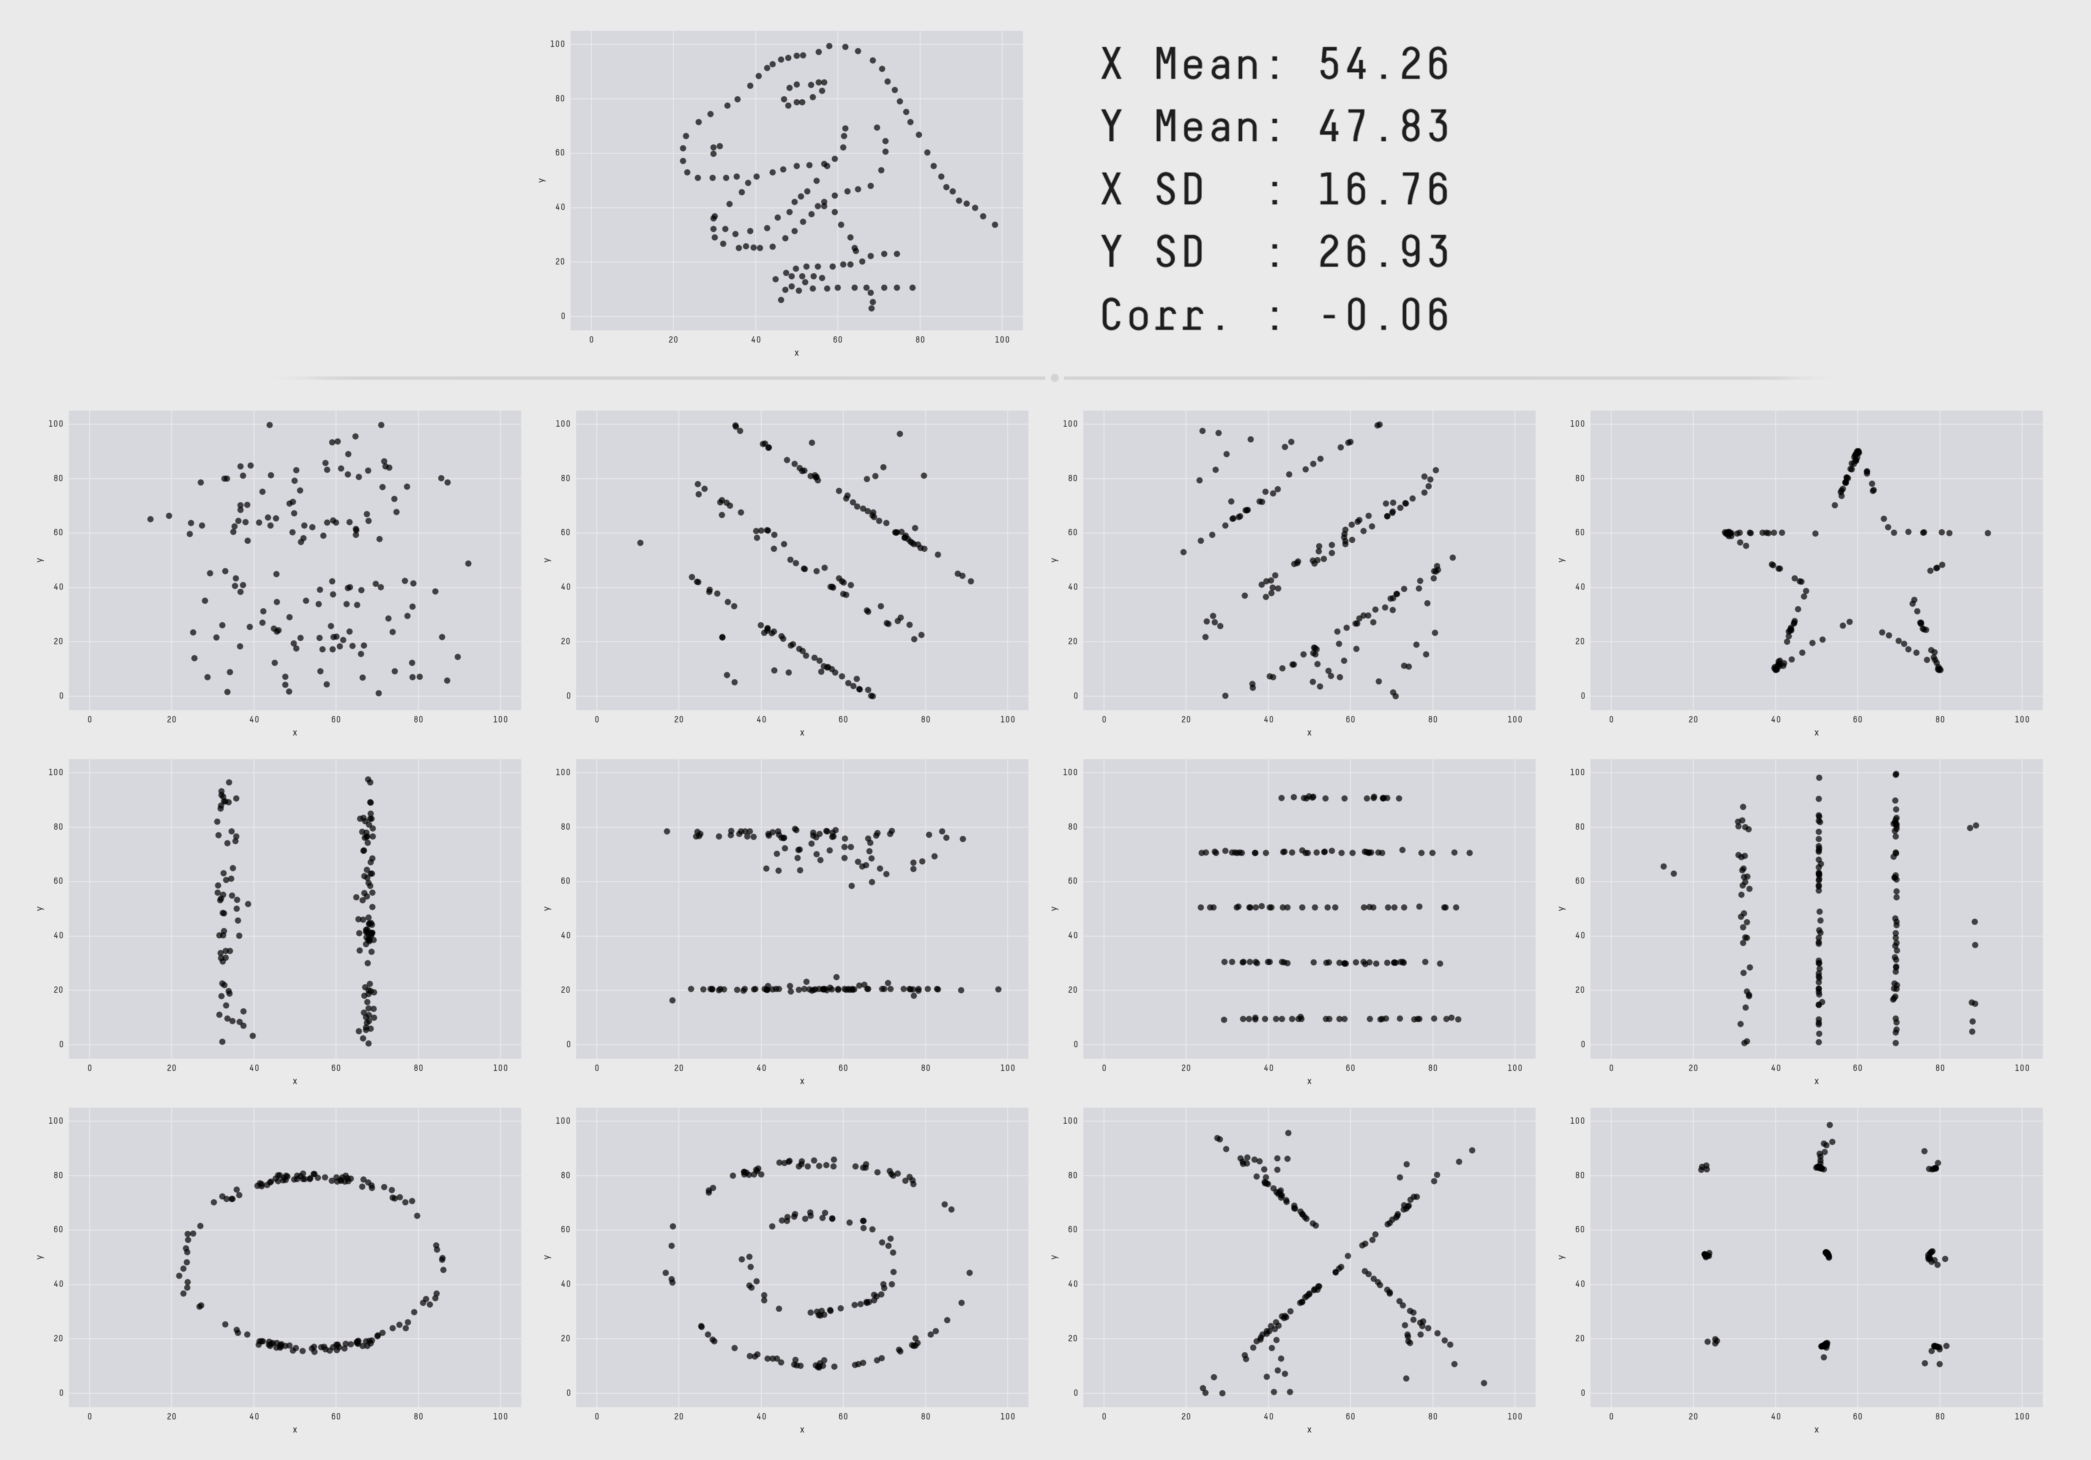
Datasaurus Dozen

